Slide 1
Lasso model specifications

Slide 2
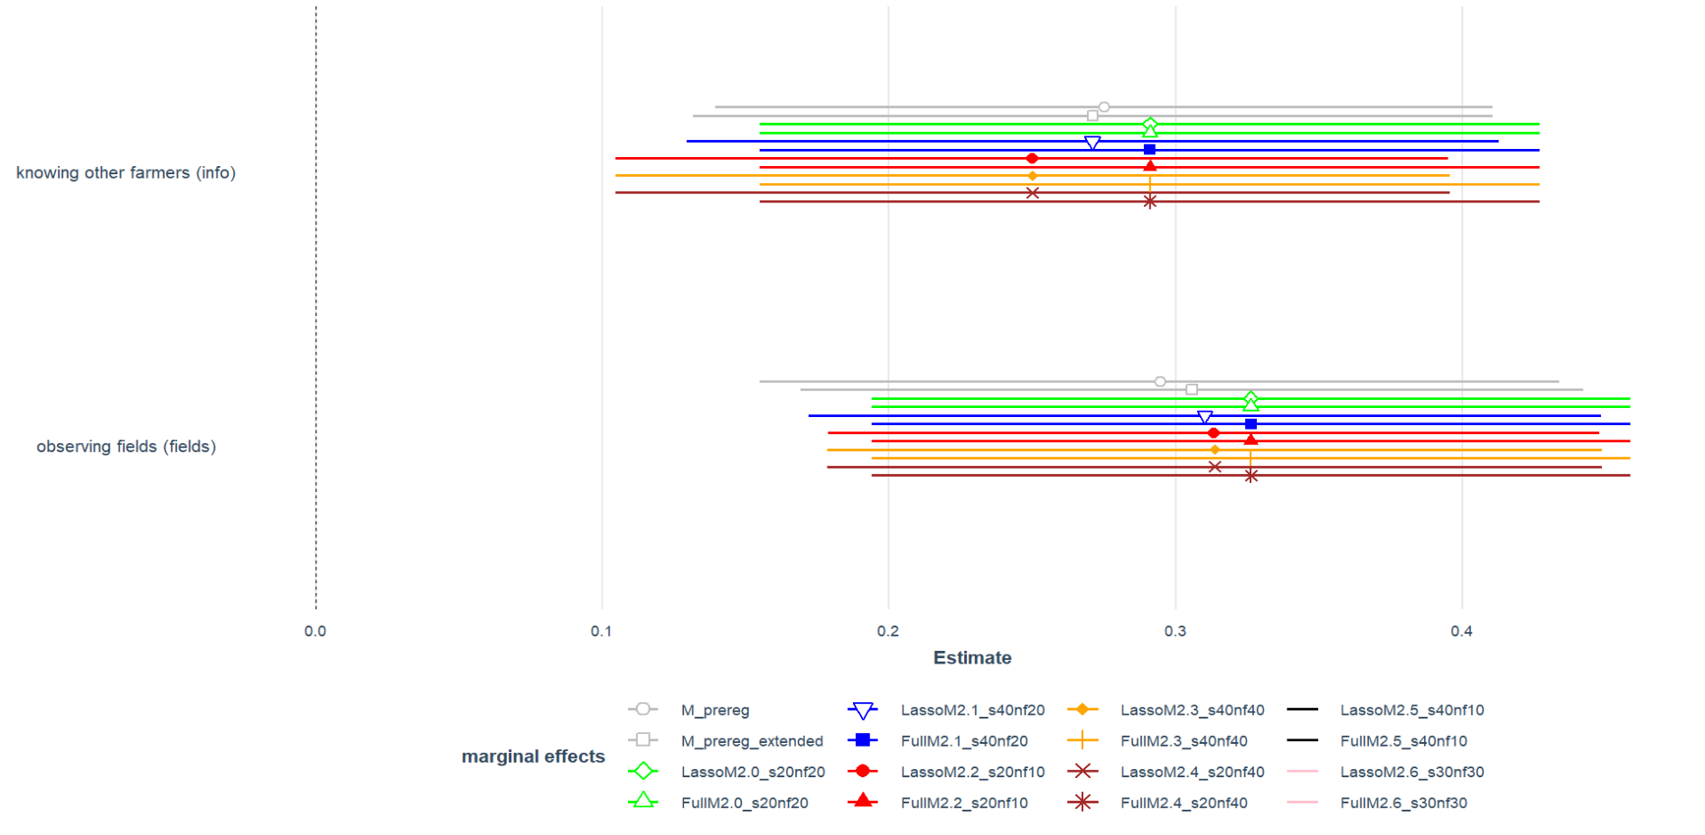
Estimate for different model specifications compared to non-Lasso results
Non-lasso models
Lasso Models
Full Models → nur eins reicht
It seems Lasso supports existing results + Lasso is more concrete than Full model

Slide 3
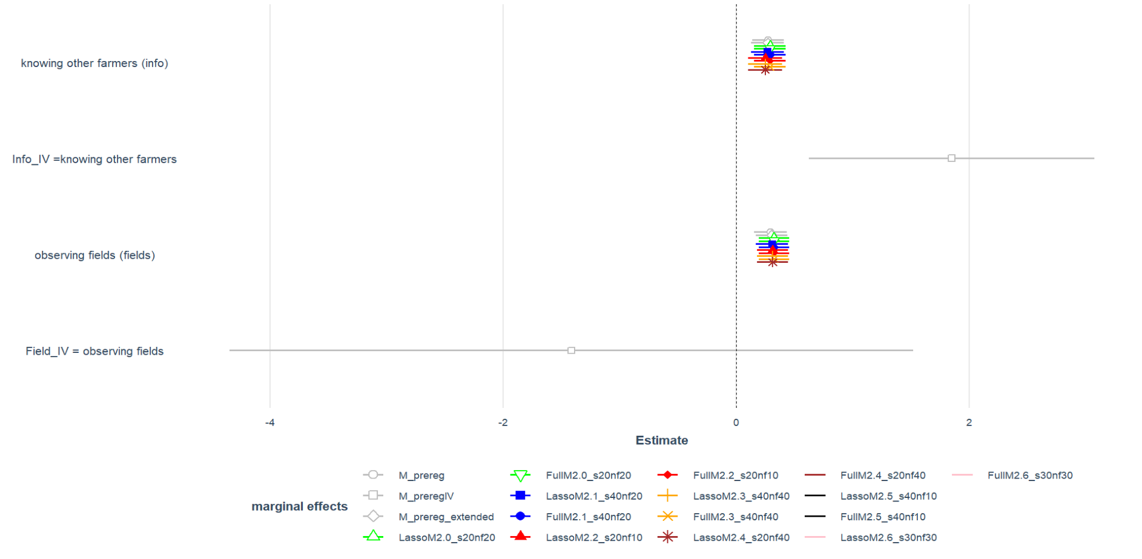
Estimate for different model specifications compared to non-Lasso results & IV

Slide 4
Problem: No vars selected for info and field

Slide 6
For 7 different model specifications only in two cases vars. For info (2.1) or field (2.0) are chosen ?!

Slide 7
 | Pre-reg | Pre-reg IV | Pre-reg extended with regional vars based on economic intuition | Lasso selected vars (out of 35) | # of selection
1 | Info_b | Info_b | Info_b | info_b | 7
2 | fields_b | fields_b | fields_b | fields_b | 7
5 | minDist_demo | minDist_demo | minDist_demo | minDist_demo | 7
6 | sq.demodist | sq.demodist | sq.demodist | farm_organic | 7
7 | age_b | age_b | age_b | age_b | 6
8 | farmsize_b | farmsize_b | farmsize_b | farmsize_b | 1
9 | AES_b | AES_b | AES_b | AES_b | 4
10 | Fabrikstandort_agg | Fabrikstandort_agg | Fabrikstandort_agg | Fabrikstandort_agg | 3
11 | FieldDist | ShareOrgFarms (IV1) |  | ShareOrgFarms | 3
12 | FieldDist^2 | ShareOrgArea (IV2) |  | ShareOrgArea | 1
13 |  |  | SB_region
14 |  |  | meanFarmSize2 | meanFarmSize2 | 4
15 |  |  | sand_content_percent_mean | sand_content_percent_mean | 4
16 |  |  | elevation_in_m_mean | elevation_in_m_mean | 2
17 |  |  |  | populationdensity | 3
18 |  |  |  | ShareSmallFarms | 3
19 |  |  |  | population | 7
20 |  |  |  | farmDens | 3
21 |  |  |  | sq.elevation_in_m_mean | 3
22 |  |  |  | sq.clay_content_percent_mean | 3
23 |  |  |  | mainly_crop | 3
24 |  |  |  | lwBetr5b_Anzahl | 2
25 |  |  |  | UAA_Organic | 2
26 |  |  |  | sq.sand_content_percent_mean | 2
27 |  |  |  | sq.demodist | 2
28 |  |  |  | UAA_Sugarbeet | 2
29 |  |  |  | UAA | 2
30 |  |  |  | areaDens | 7
31 |  |  |  | clay_content_percent_mean | 7
32 |  |  |  | ShareSB | 1
33 |  |  |  | lwBetr_Anzahl | 1
34 |  |  |  | lwBetrOrganic_Anzahl | 1
35 |  |  |  | UAA_arable | 1
36 |  |  |  | lwBetrUnter5_Anzahl | 4
37 |  |  |  | Area | 7
Distance var. looked at separately + in subsample of observers

Slide 8
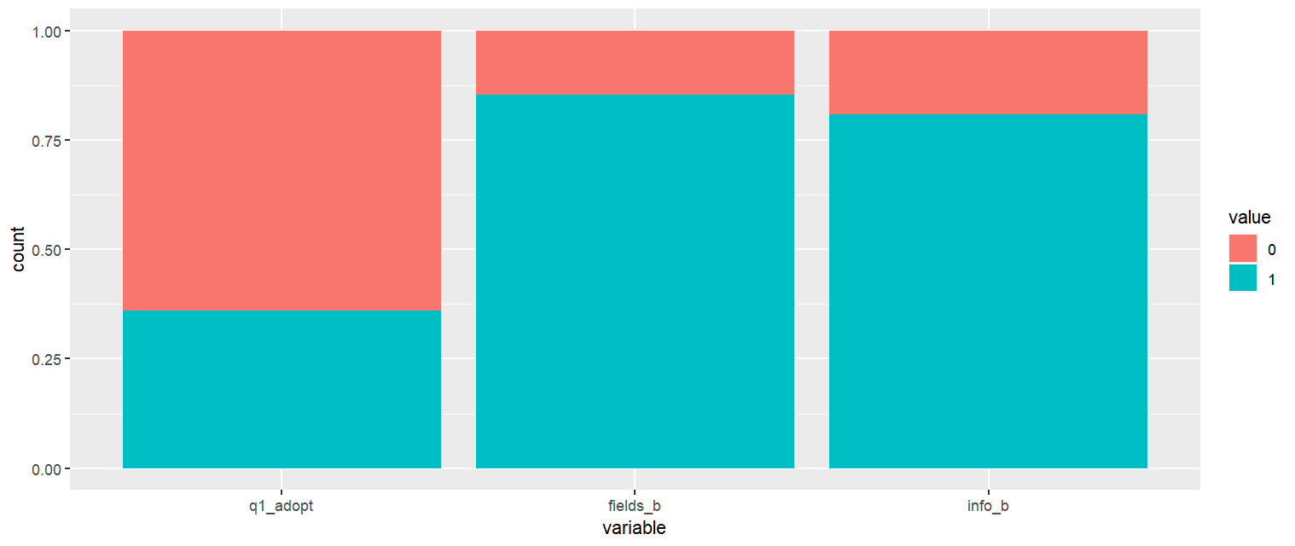
Vars of interest

Slide 9
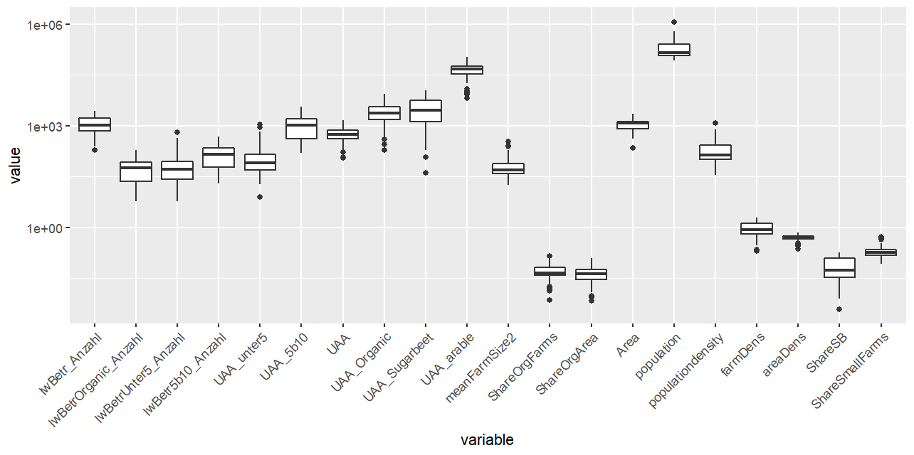
Farm structural vars
Exclude due to many missing values → als share

Slide 10
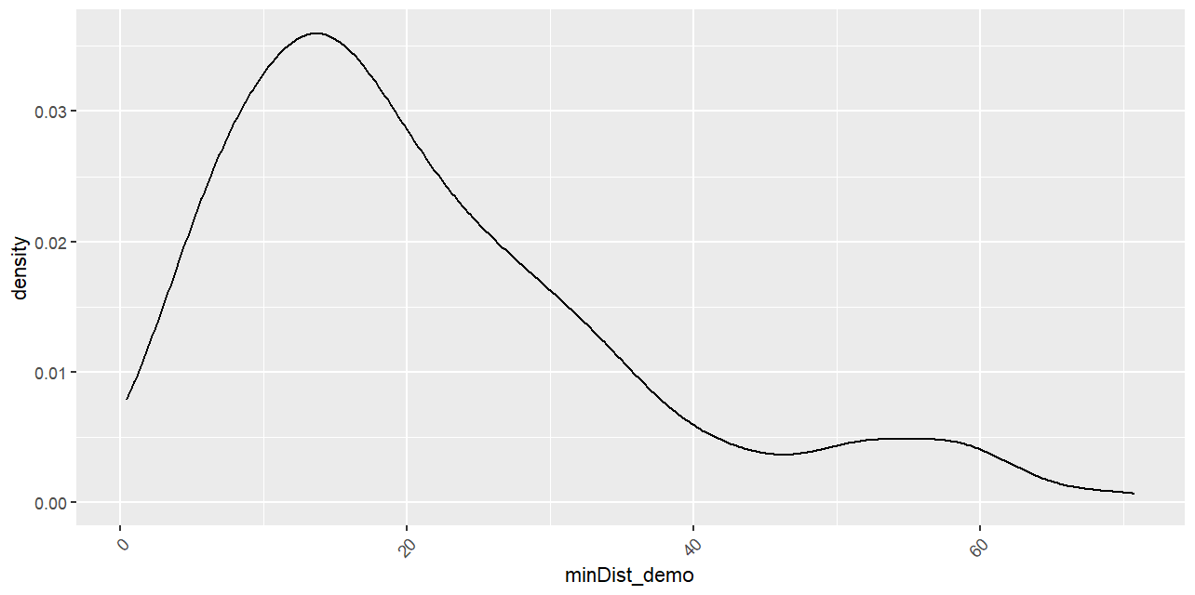
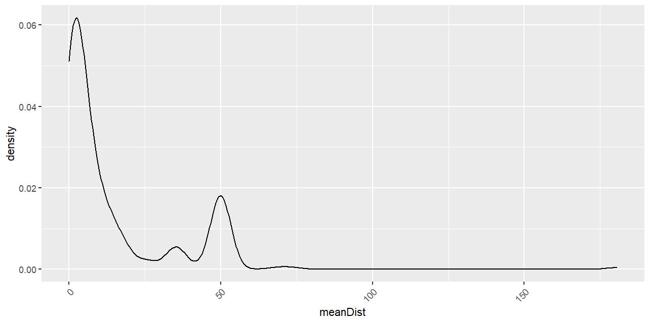
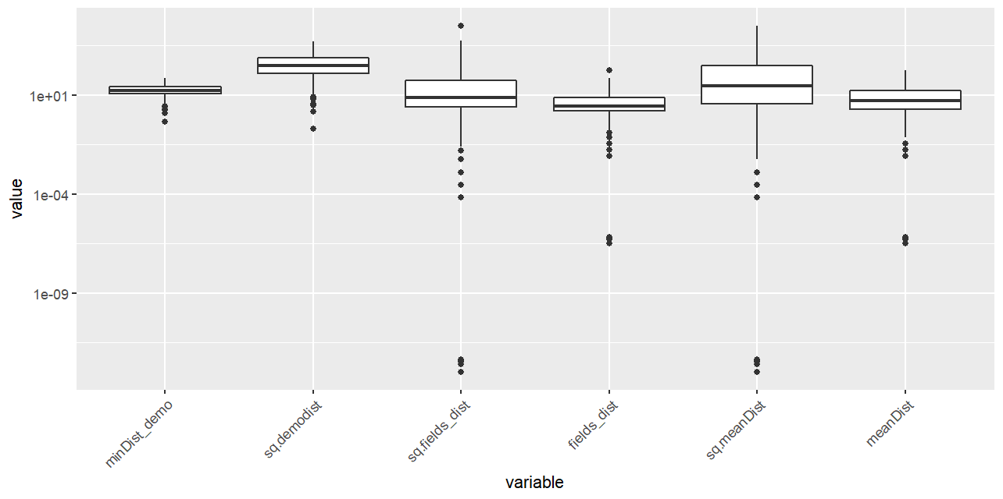
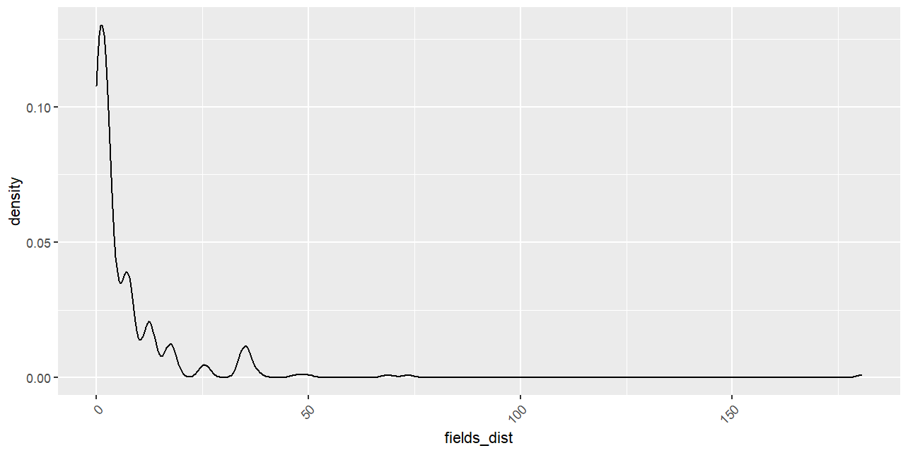
Distance vars
Those who don’t observe set to 50, @AM:need to cut others

Slide 11
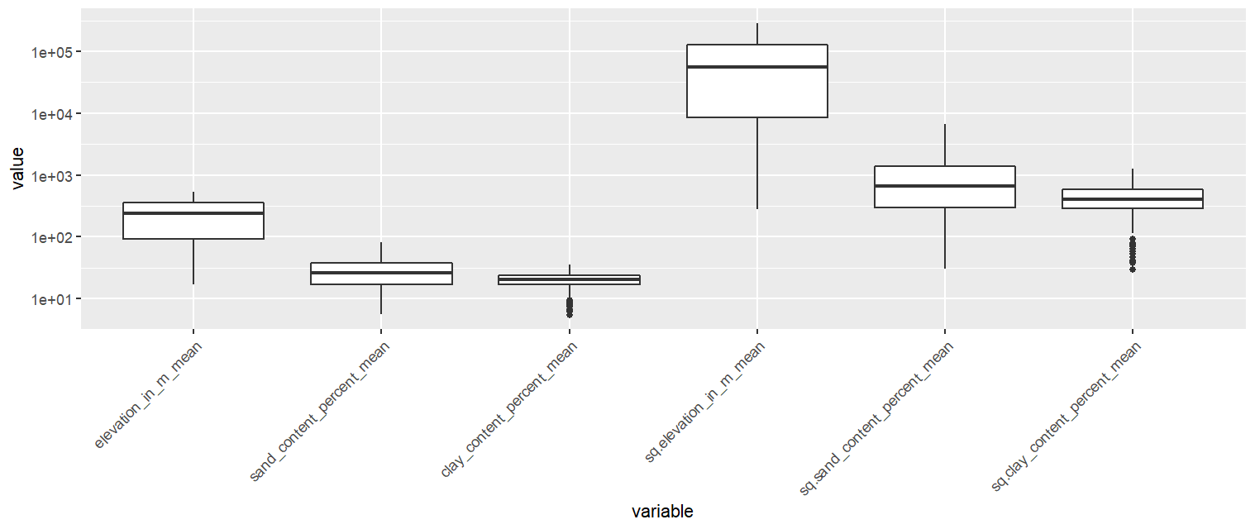
Soil vars

Slide 12
Sugarbeet vars

Slide 13
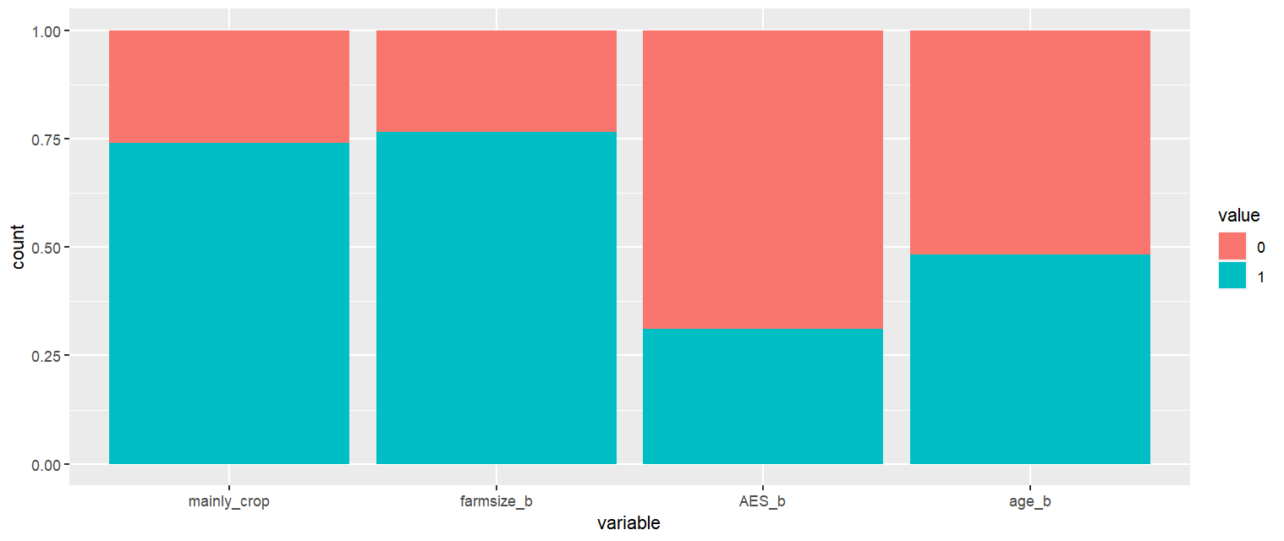
Demographics from survey

Slide 14
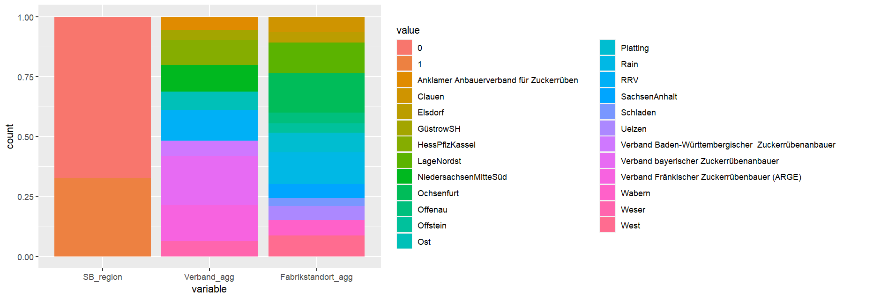
SB production structures
Take only one of those, currently (Fabrikstandort_agg) otherwise partial overlap → @AM: check if results differ if Verband_agg taken
Binary version of “Share_SB” (takes 11 if > 10%)

Slide 15
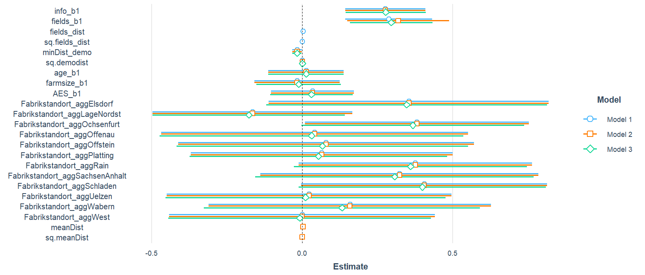
How should distance to fields observed enter? → not all!

